Slide 1
Data Science 100 Lecture 9: Modeling and Estimation II
?
Slides by:
Joseph E. Gonzalez, jegonzal@berkeley.edu
Josh Hug, hug@cs.berkeley.edu

Slide 2
Summary of Model Estimation (so far…)
Define the Model: simplified representation of the world
Use domain knowledge but … keep it simple!
Introduce parameters for the unknown quantities
Define the Loss Function: measures how well a particular instance of the model “fits” the data
We introduced L², L¹, and Huber losses for each record
Take the average loss over the entire dataset
Minimize the Loss Function: find the parameter values that minimize the loss on the data
We did this both graphically and analytically.
Today we will also discuss how to compute the loss numerically.

Slide 3
Squared Loss
Widely used loss!
The “error” in our prediction
The predicted value
An observed data point
Also known as the the L² loss (pronounced “el two”)
Reasonable?
θ = y ➔ good prediction ➔ good fit ➔ no loss!
θ far from y ➔ bad prediction ➔ bad fit ➔ lots of loss!

Slide 4
Absolute Loss
Absolute value
Also known as the the L¹ loss (pronounced “el one”)
Examples:
If our measurement is 17, and I predict 23, the loss is 6.
If our measurement is 17, and I predict 18, the loss is 1.
Notes:
Name one key difference between this plot and the previous one.
Vertical scale: L2 is much more sensitive.
Sharp corner: non-differentiable.
Curvature: L2 increasingly penalizes outliers.

Slide 5

Average Loss
A natural way to define the loss on our entire dataset is to compute the average of the loss on each record.
The set of n data points
Test your understanding:
Suppose we have measure 4 data points, yielding 5, 7, 8, and 9. What will be the average loss for the prediction $θ=8$?

Slide 6
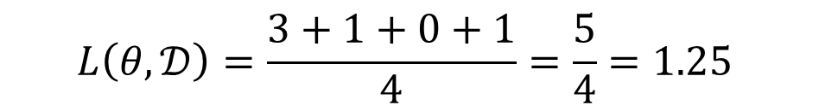
Average Loss
A natural way to define the loss on our entire dataset is to compute the average of the loss on each record.
The set of n data points
Test your understanding:
Suppose we have measure 4 data points, yielding 5, 7, 8, and 9. What will be the average loss for the prediction $θ=8$?
$$L\left(θ, 𝒟\right)=\frac{3+1+0+1}{4}=\frac{5}{4}=1.25$$

Slide 7
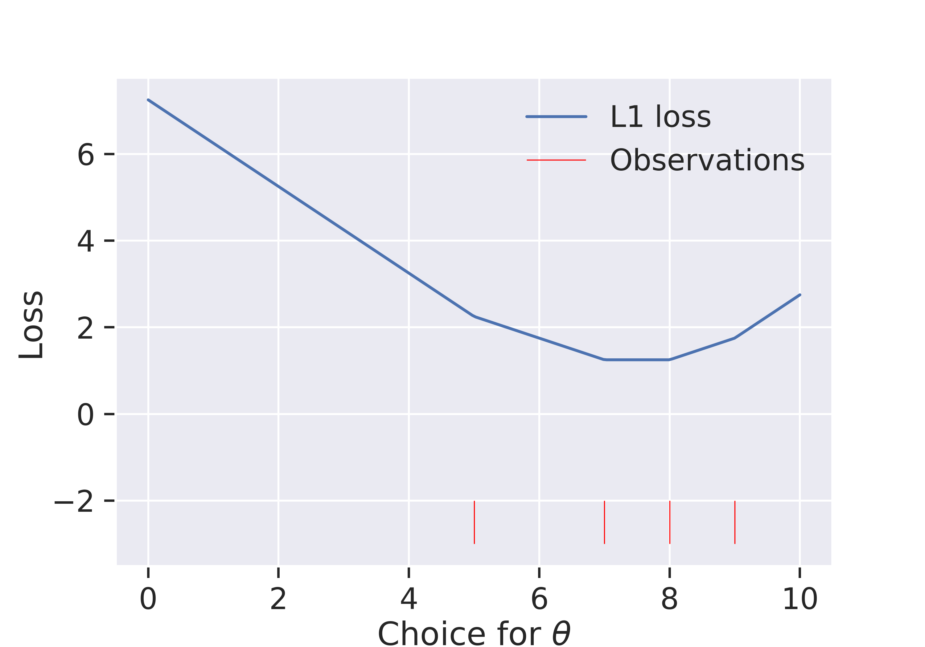
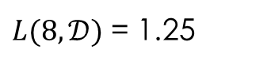
Average L¹ loss Visualization
$L(8, 𝒟)$ = 1.25
Suppose we have measure 4 data points, yielding 5, 7, 8, and 9. What will be the average loss for the prediction $θ=8$?
$$L\left(θ, 𝒟\right)=\frac{3+1+0+1}{4}=\frac{5}{4}=1.25$$

Slide 8
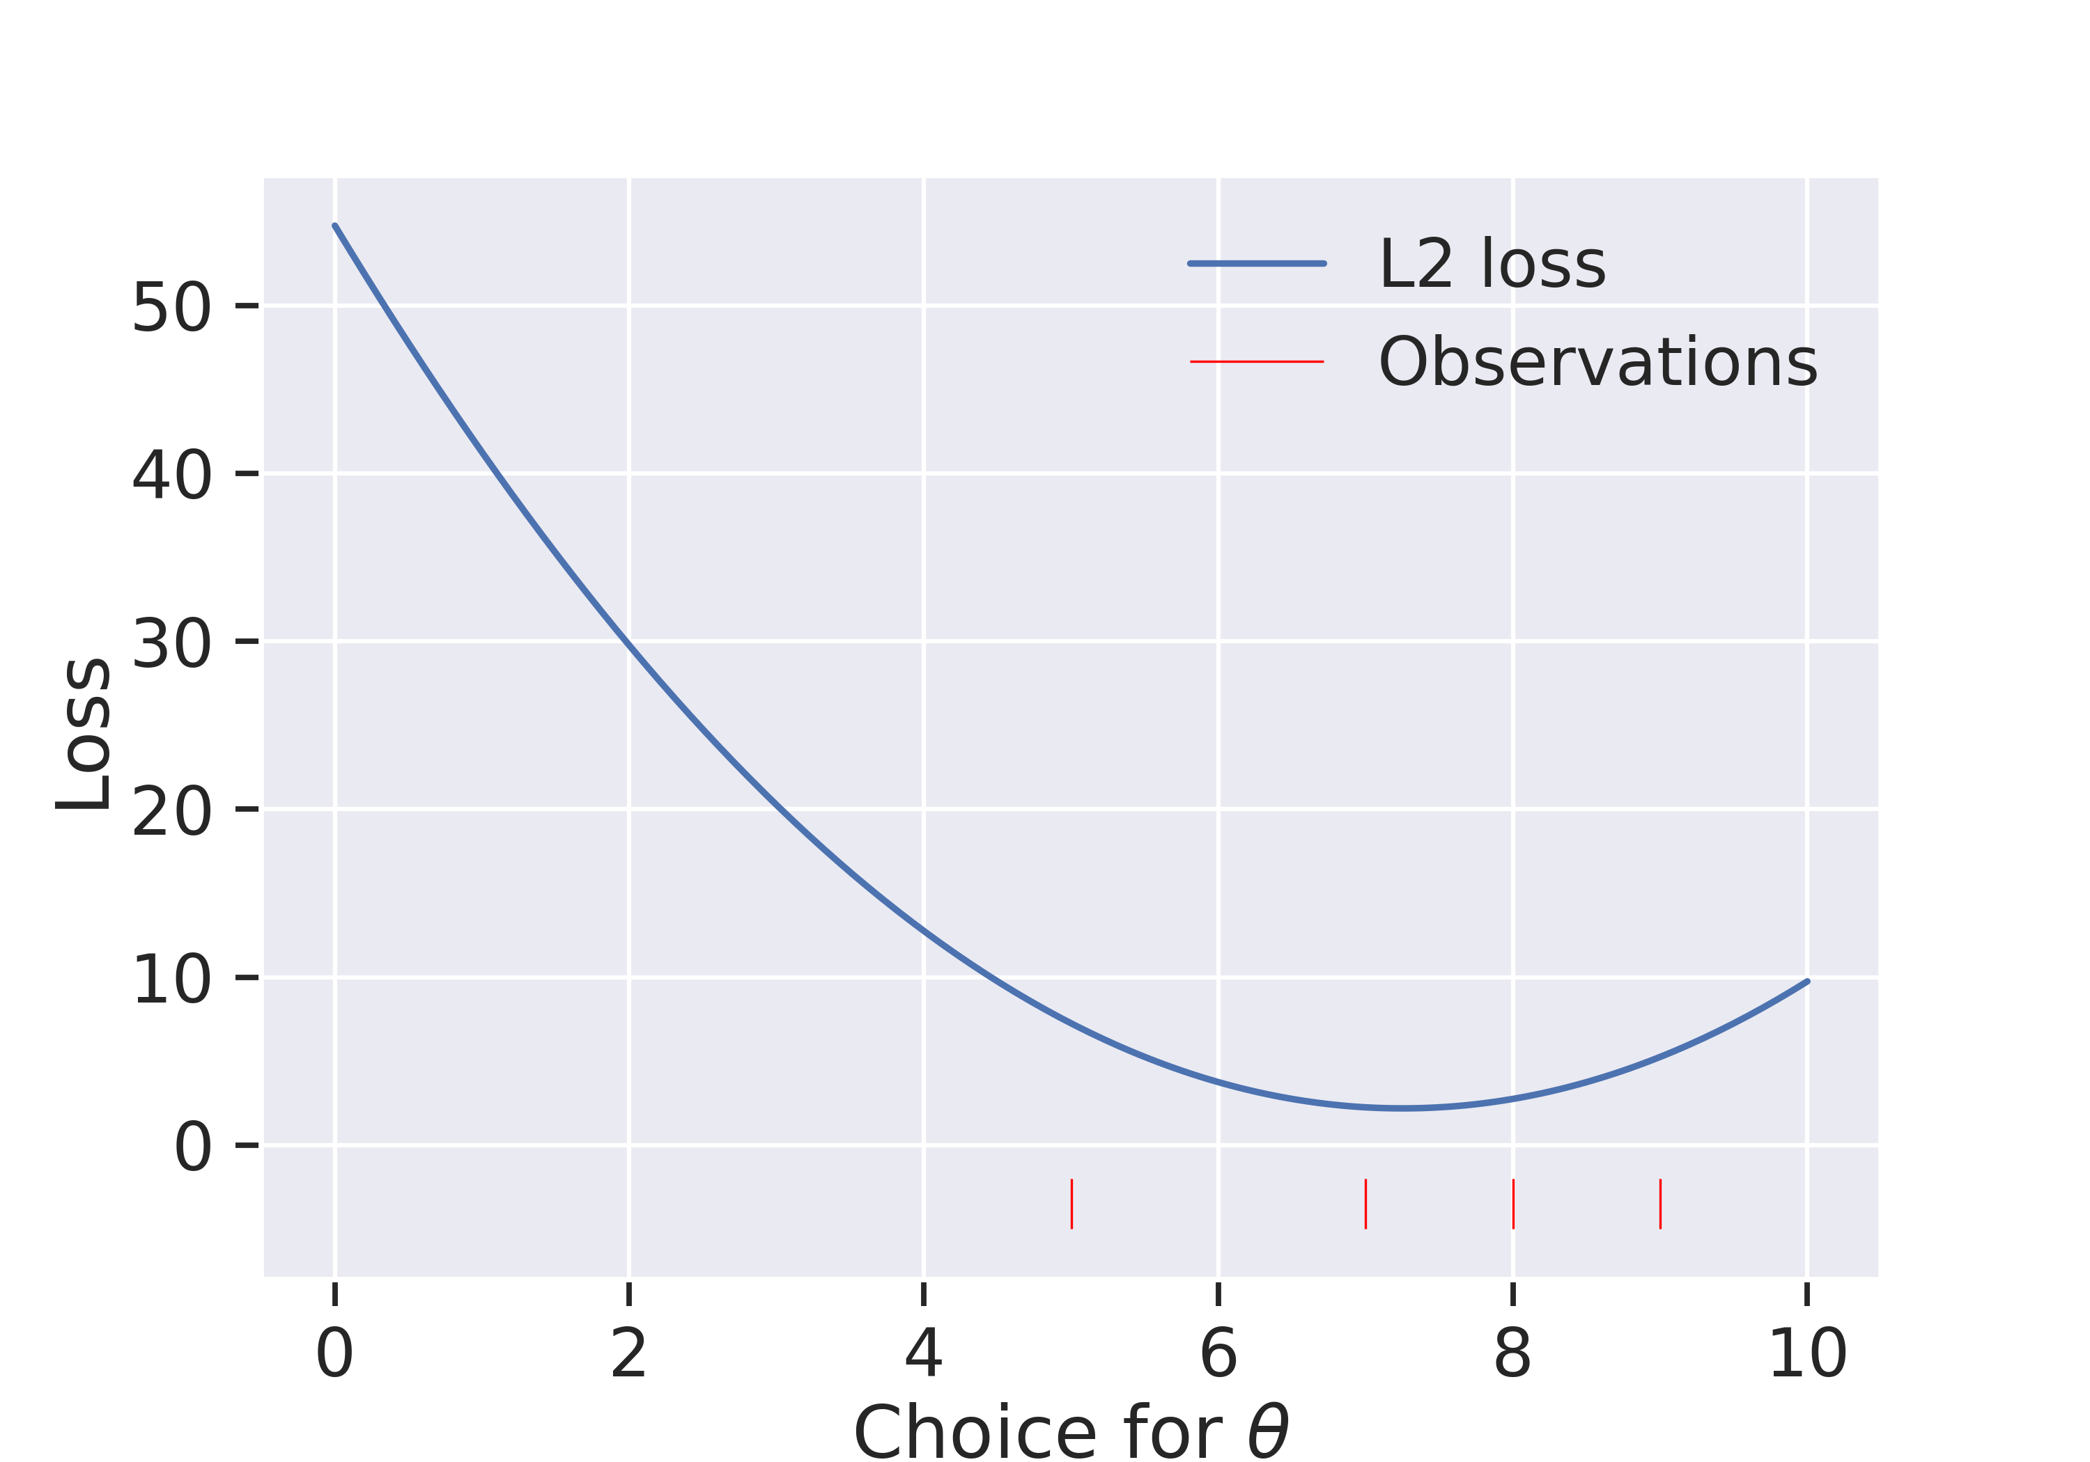
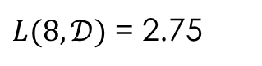
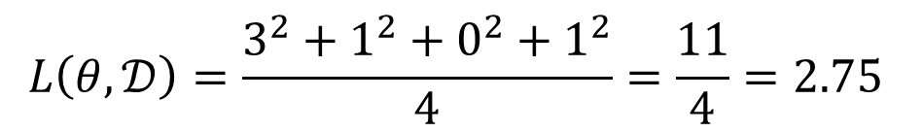
Average L² loss Visualization
$L(8, 𝒟)$ = 2.75
Suppose we have measure 4 data points, yielding 5, 7, 8, and 9. What will be the average loss for the prediction $θ=8$?
$$L\left(θ, 𝒟\right)=\frac{3^{2}+1^{2}+0^{2}+1^{2}}{4}=\frac{11}{4}=2.75$$

Slide 9
Calculus for Loss Minimization
General Procedure:
Verify that function is convex (we often will assume this…)
Compute the derivative
Set derivative equal to zero and solve for the parameters
Using this procedure we discovered:

Slide 10
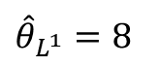
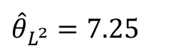
Calculus for Loss Minimization (Visual)
${\hat{θ}}_{L^{1}}=8$
${\hat{θ}}_{L^{2}}=7.25$
Using this procedure we discovered:

Slide 11
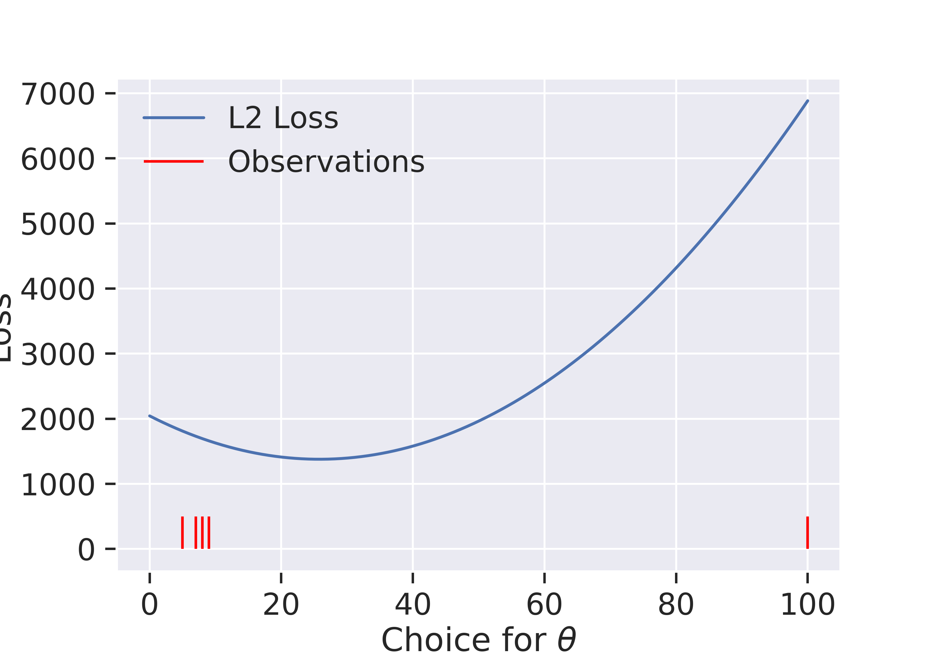
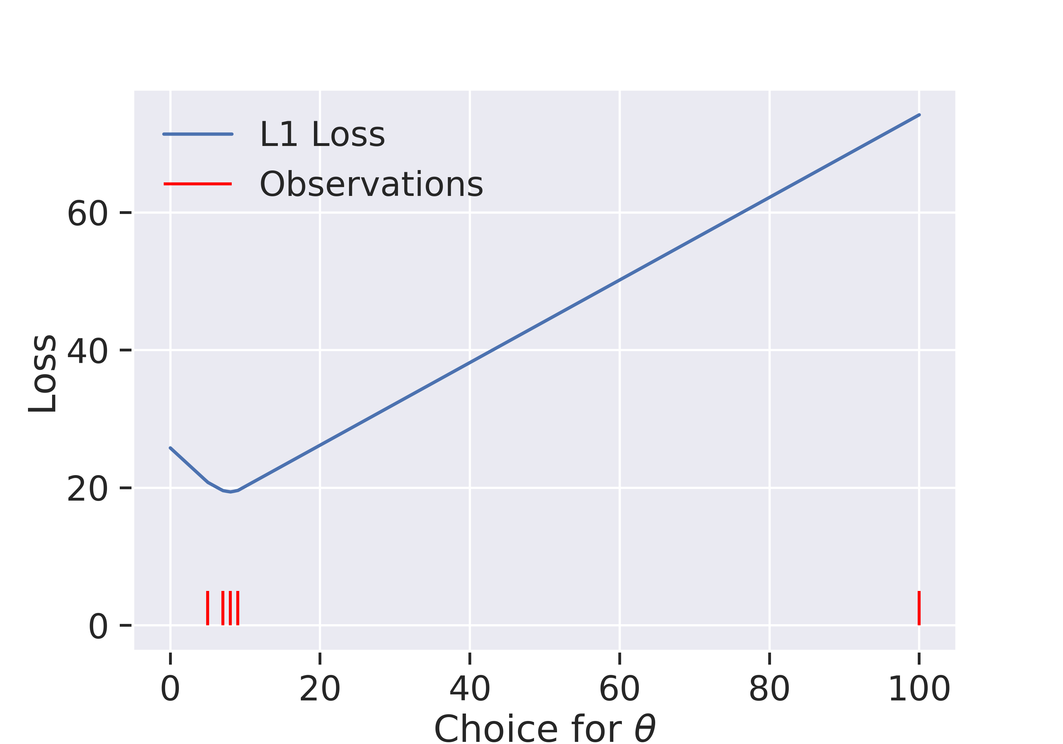
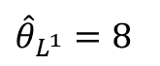
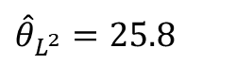
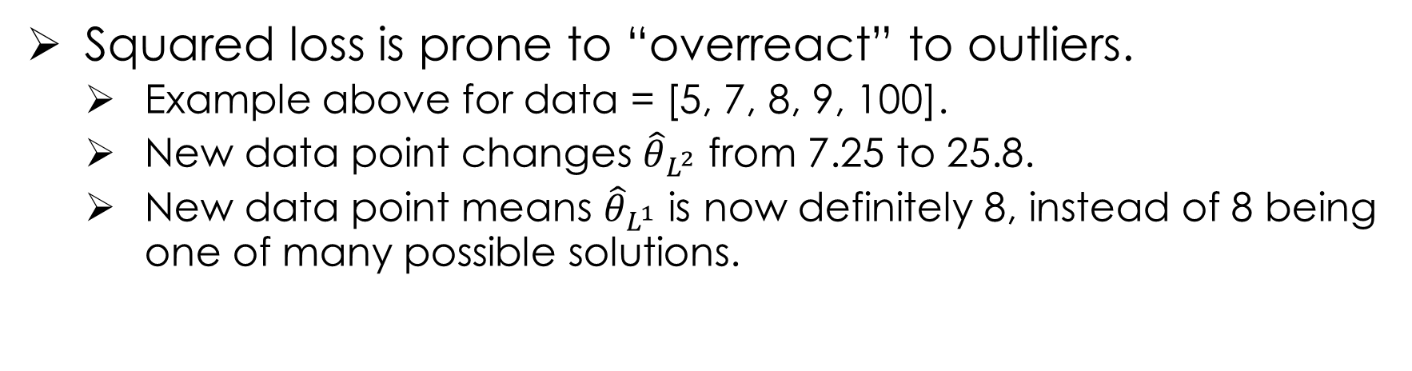
Squared Loss vs. Absolute Loss
${\hat{θ}}_{L^{1}}=8$
${\hat{θ}}_{L^{2}}=25.8$
Squared loss is prone to “overreact” to outliers.
Example above for data = [5, 7, 8, 9, 100].
New data point changes ${\hat{θ}}_{L^{2}}$ from 7.25 to 25.8.
New data point means ${\hat{θ}}_{L^{1}}$ is now definitely 8, instead of 8 being one of many possible solutions.

Slide 12
Summary on Loss Functions
Loss functions: a mechanism to measure how well a particular instance of a model fits a given dataset
Squared Loss: sensitive to outliers but a smooth function
Absolute Loss: less sensitive to outliers but not smooth
Huber Loss: less sensitive to outliers and smooth but has an extra parameter to deal with
Why is smoothness an issue? → Optimization! (more later)

Slide 13
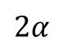
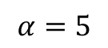
Huber Loss (1964)
$$α=5$$
Parameter 𝛼 that we need to choose.
Reasonable?
θ = y ➔ good prediction ➔ good fit ➔ no loss!
θ far from y ➔ bad prediction ➔ bad fit ➔ some loss
A hybrid of the L2 and L1 losses…
$$2α$$
Notes:
Named after Peter Huber, a swiss staticitian

Slide 14
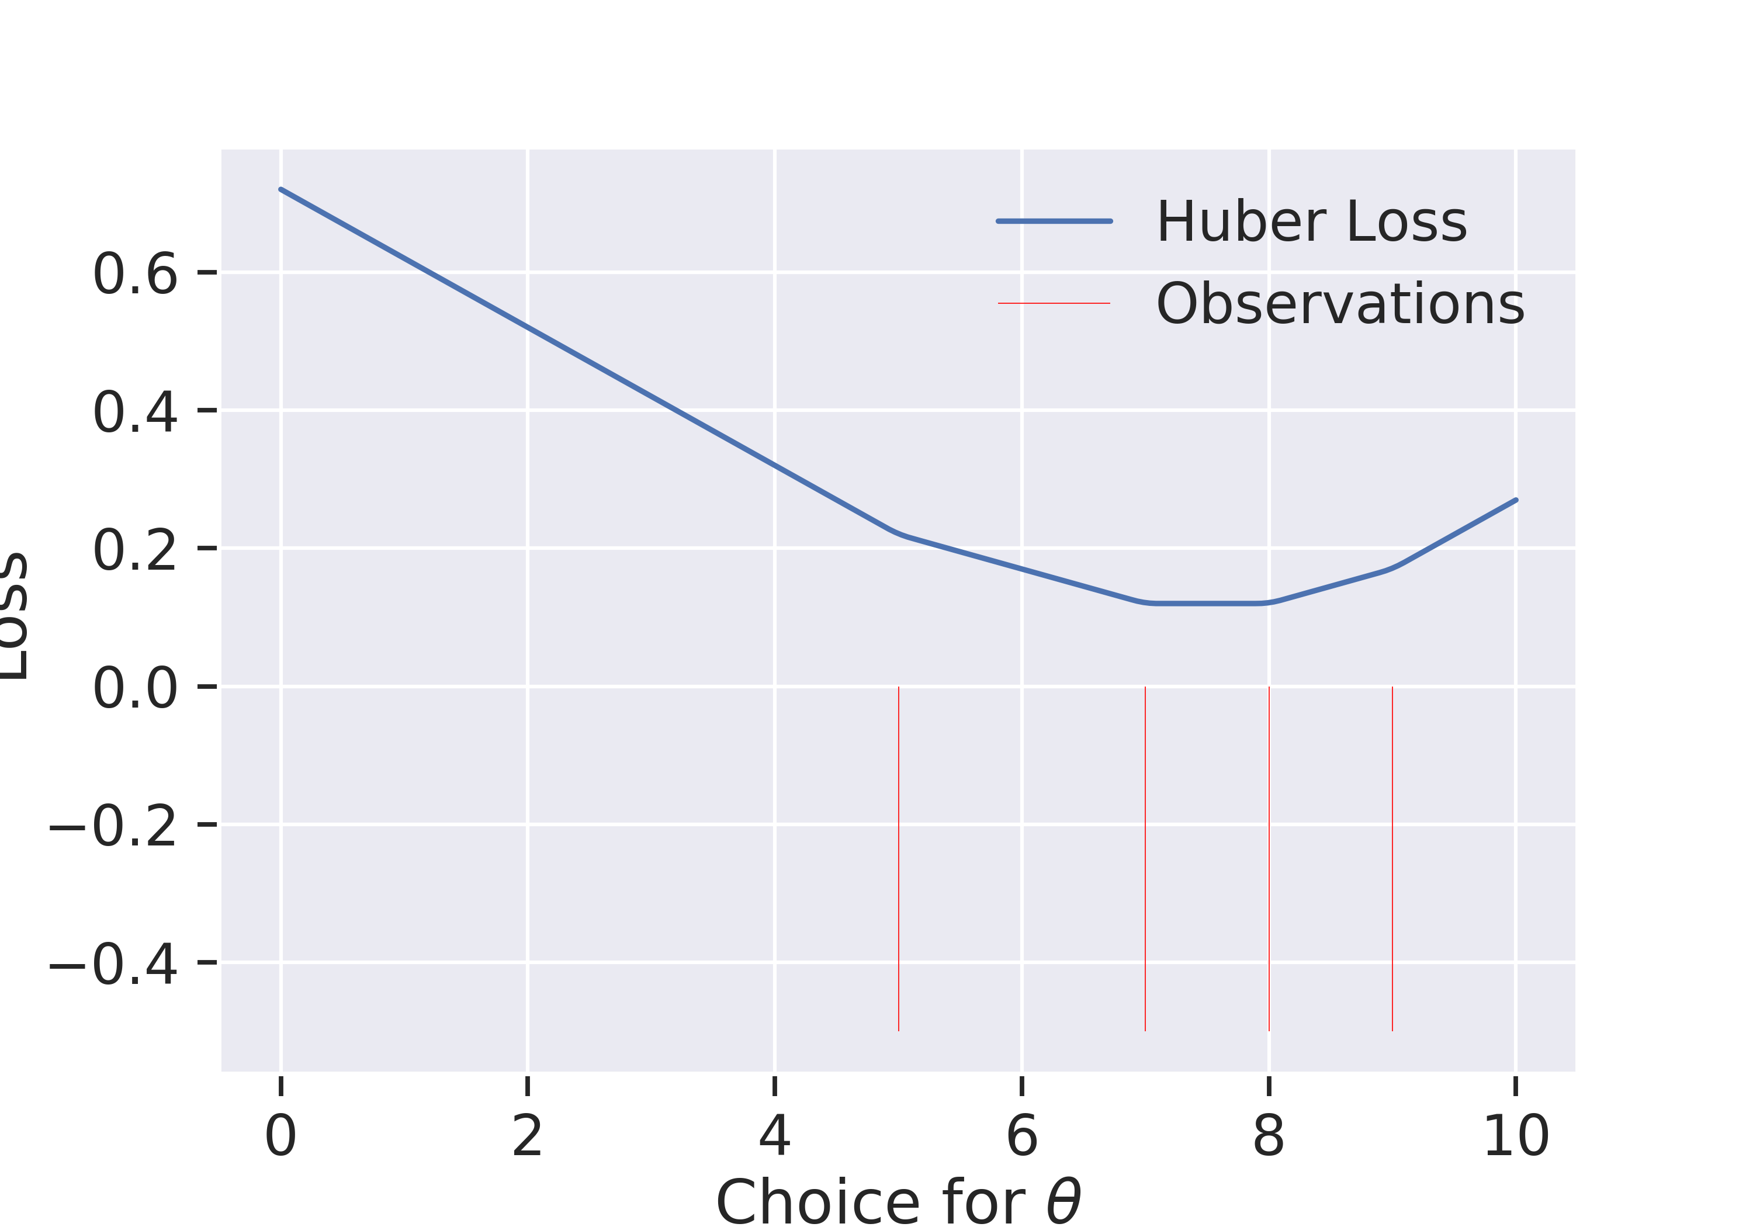
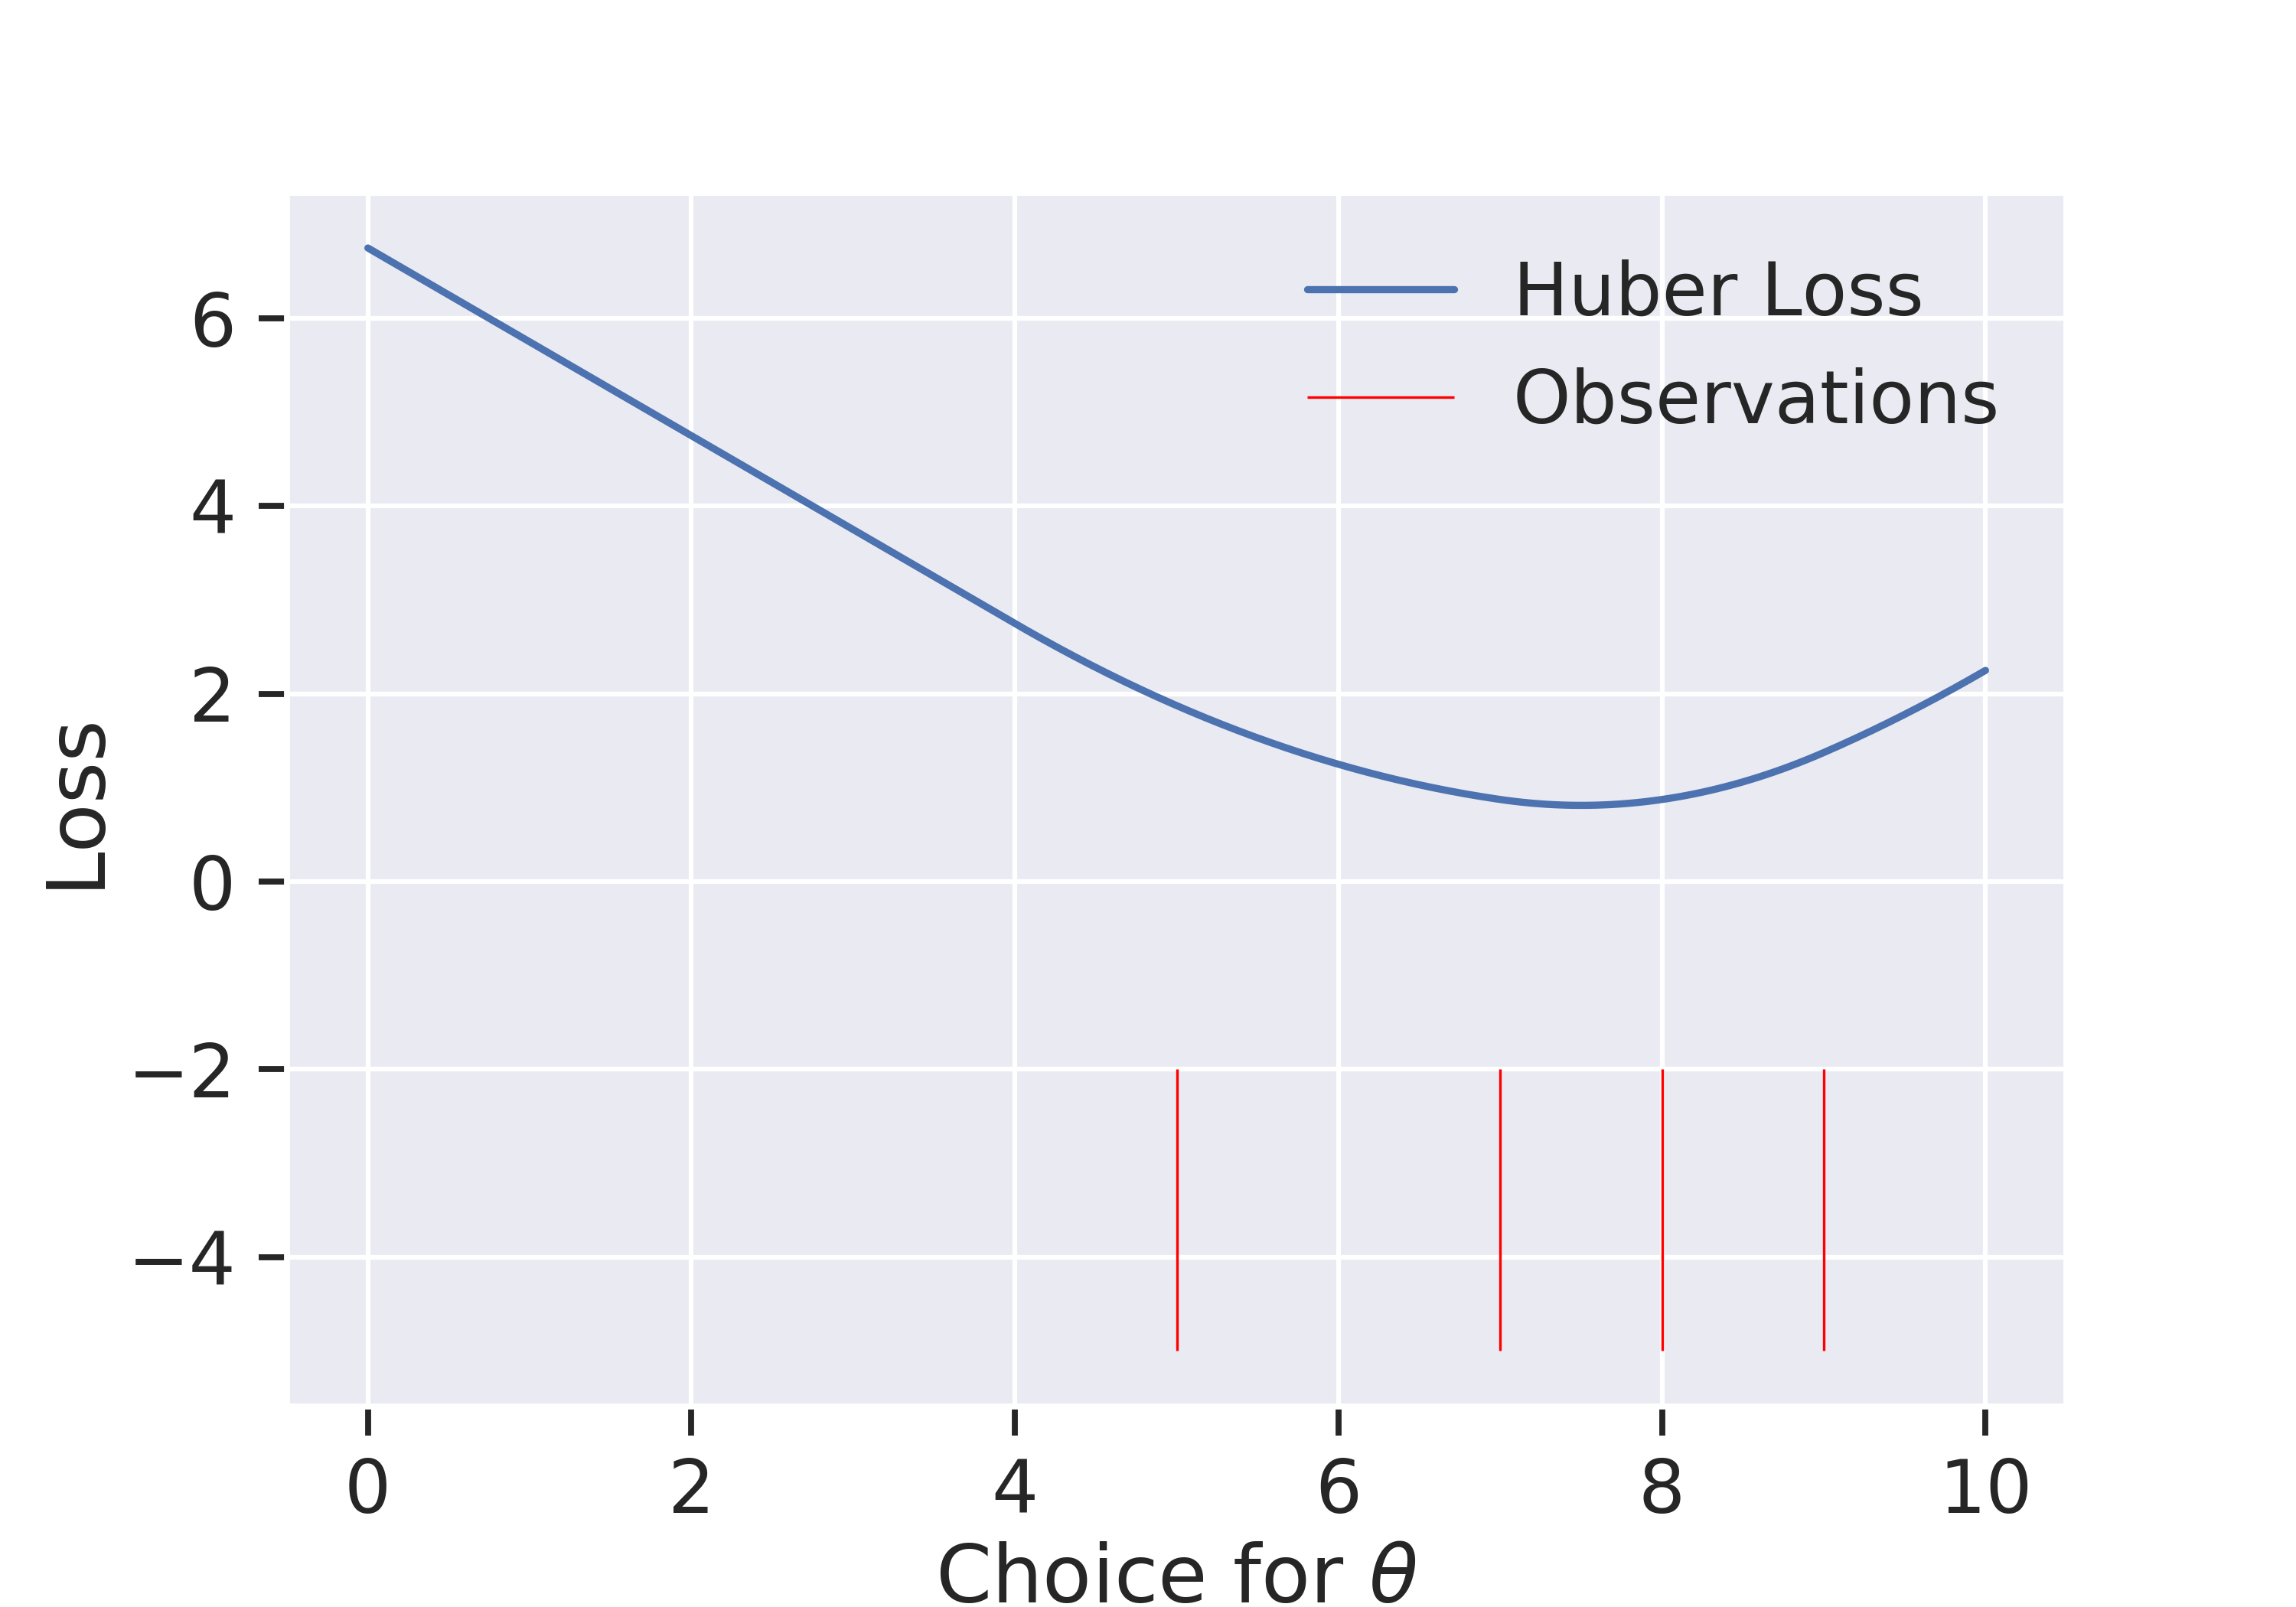
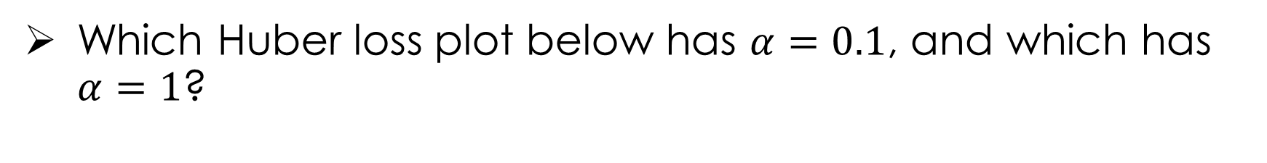
Name that loss (round two)
Which Huber loss plot below has $α=0.1$, and which has $α=1$?

Slide 15
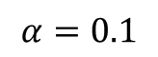
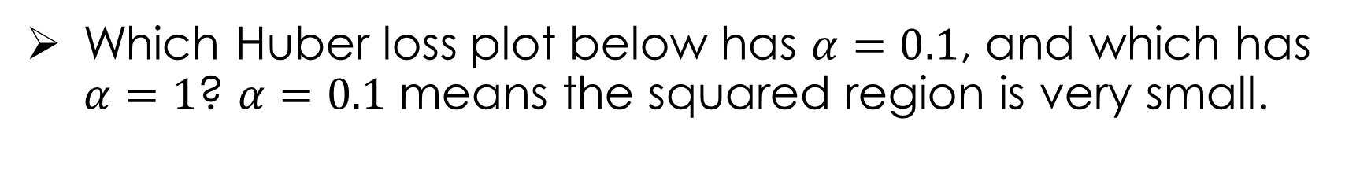
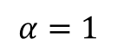
Name that loss (round two)
Which Huber loss plot below has $α=0.1$, and which has $α=1$? $α=0.1$ means the squared region is very small.
$$α=0.1$$
$$α=1$$

Slide 16
Calculus for Loss Minimization
General Procedure:
Verify that function is convex (we often will assume this…)
Compute the derivative
Set derivative equal to zero and solve for the parameters
Using this procedure we discovered:

Slide 17
Minimizing the Average Huber Loss
Take the derivative of the average Huber Loss

Slide 18
Minimizing the Average Huber Loss
Take the derivative of the average Huber Loss

Slide 19
Minimizing the Average Huber Loss
Take the derivative of the average Huber Loss

Slide 20
Minimizing the Average Huber Loss
Take the derivative of the average Huber Loss

Slide 21
Minimizing the Average Huber Loss
Take the derivative of the average Huber Loss
Set derivative equal to zero:
Solution?
No simple analytic solution …
We can still plot the derivative

Slide 22
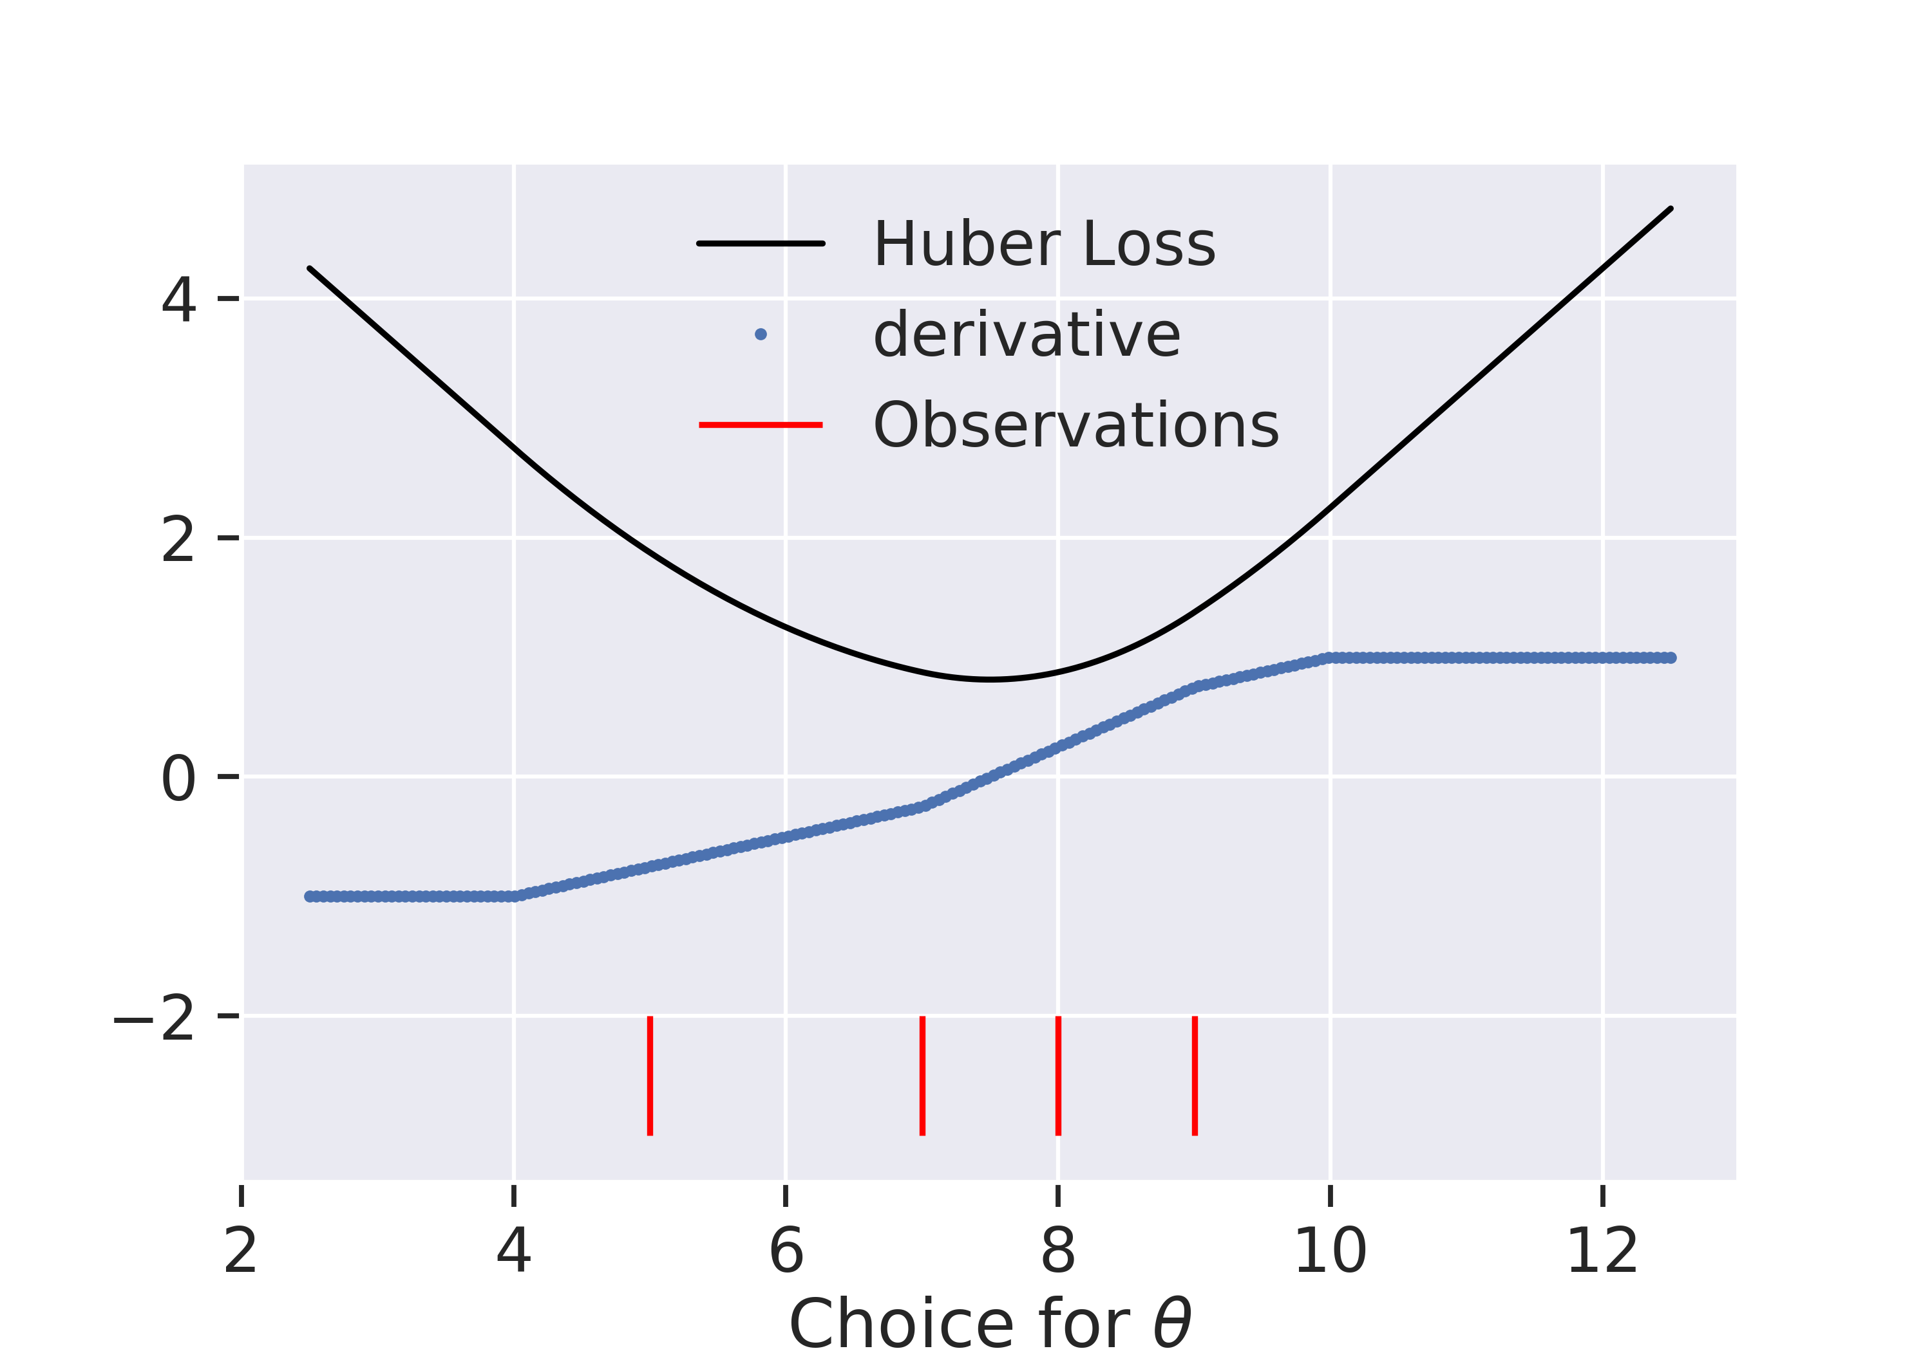
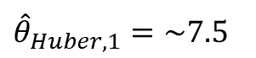
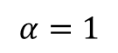
Visualizing the Derivative of the Huber Loss
$$α=1$$
${\hat{θ}}_{Huber, 1}=\sim 7.5$
Large 𝜶 ➔ unique optimum like squared loss

Slide 23
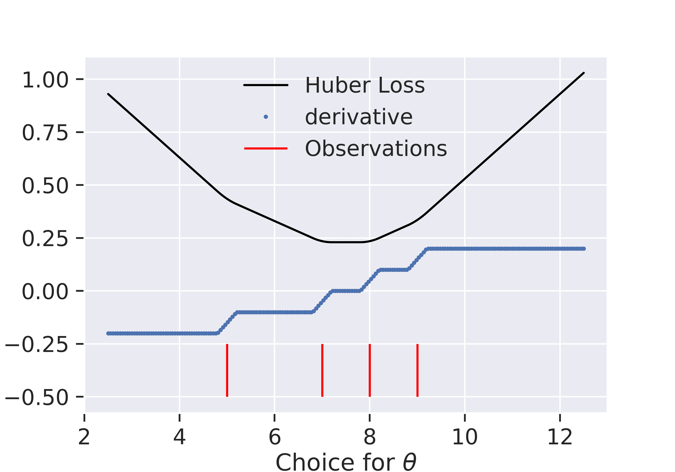
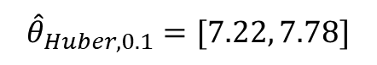
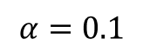
Visualizing the Derivative of the Huber Loss
$$α=0.1$$
$$α=1$$
Loss
$${\hat{θ}}_{Huber, 0.1}=[7.22, 7.78]$$
Derivative is continuous
Small 𝜶 ➔many optima
Large 𝜶 ➔ unique optimum like squared loss
Notes:
If time, make a movie showing smooth transition

Slide 24
Numerical Optimization

Slide 25
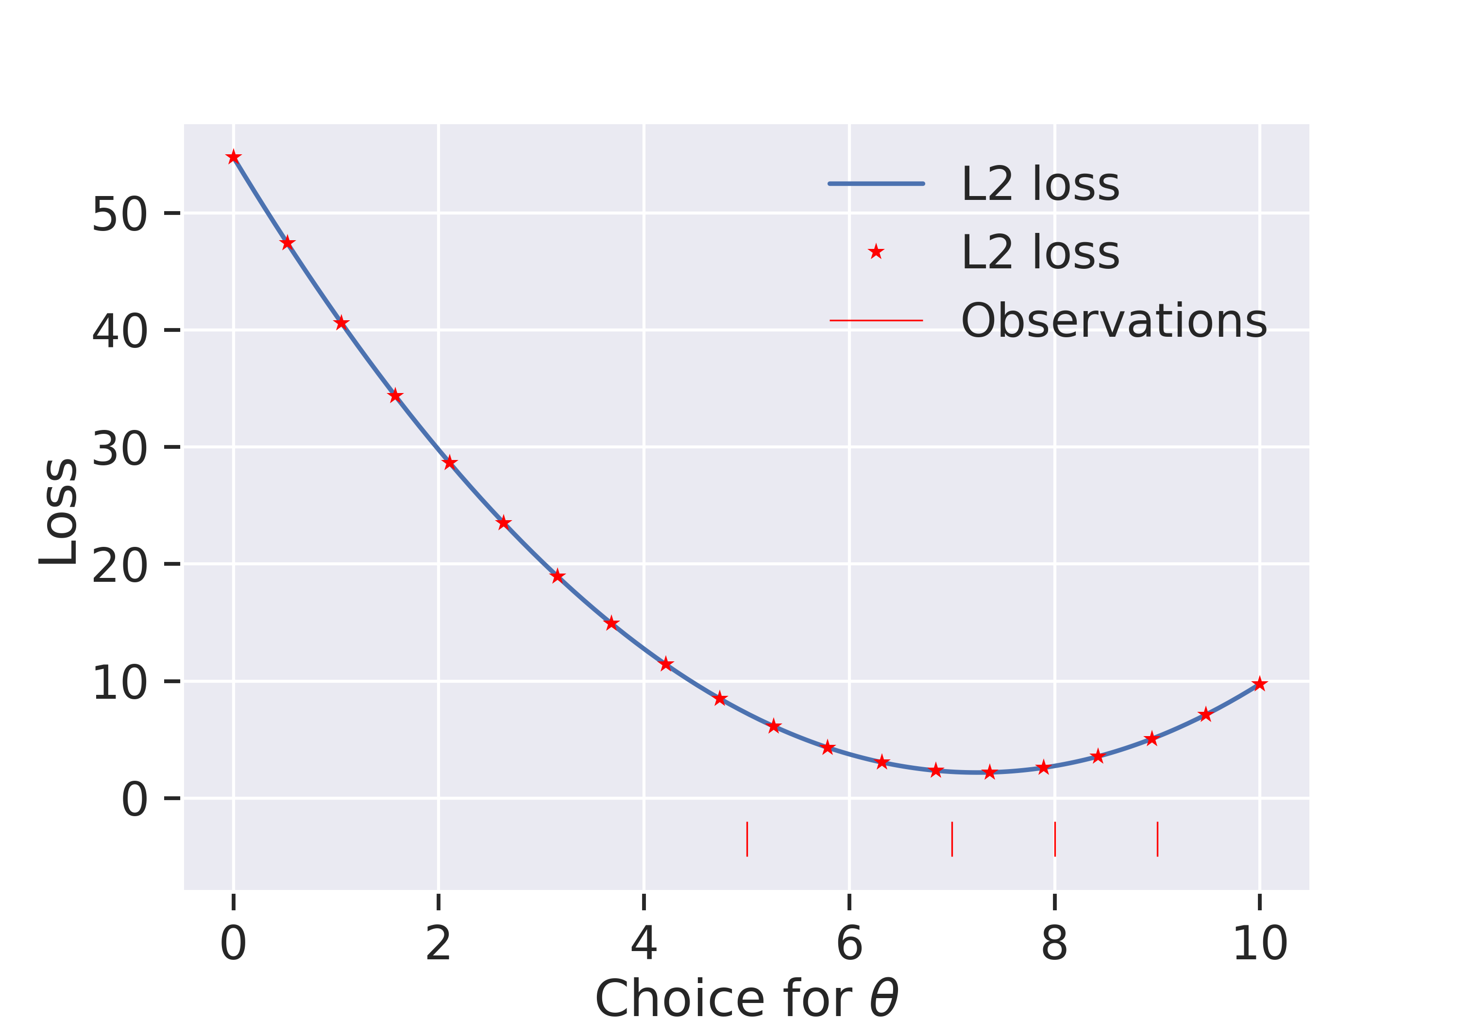
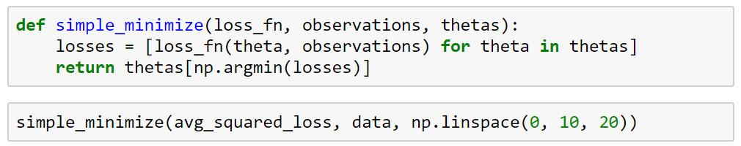
Minimizing the Loss Function Using Brute Force
Not a good approach:
Slow.
Range of guesses may miss the minimum.
Guesses may be too coarsely spaced.

Slide 26
Minimizing the Loss Function Using the Derivative
Observation, derivative is:
Negative to the left of the solution.
Positive to the right of the solution.
Zero at the solution.
huber_loss_derivative(4, data, 1)
-1.0
huber_loss_derivative(6, data, 1)
-0.5
Derivative tells us which way to go!
huber_loss_derivative(9, data, 1)
0.75
huber_loss_derivative(8, data, 1)
0.25
huber_loss_derivative(7.5, data, 1)
0.0

Slide 27
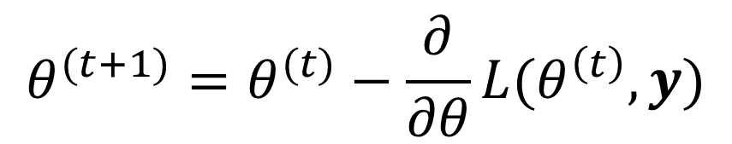
Minimizing the Loss Function Using Gradient Descent
In gradient descent we use the sign AND magnitude to decide our next guess.
$$θ^{(t+1)}=θ^{(t)}−\frac{∂}{∂θ}L(θ^{\left(t\right)}, y)$$
huber_loss_derivative(5, data, 1)
-0.75
Intuition: It’s vaguely like rolling down a hill. Steeper the hill, the faster you go.
huber_loss_derivative(5.75, data, 1)
-0.5625
huber_loss_derivative(6.3125, data, 1)
-0.421875
huber_loss_derivative(6.734375, data, 1)
-0.31640625
huber_loss_derivative(7.05078125, data, 1)
...

Slide 28
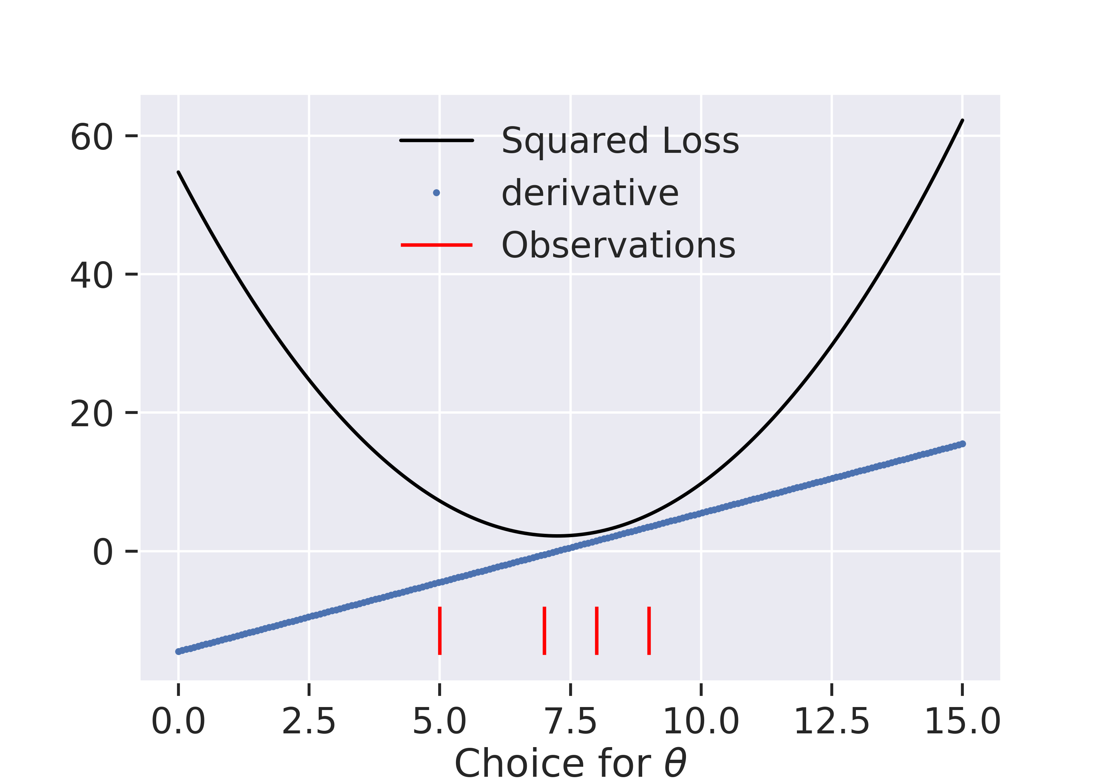
Minimizing the Loss Function Using Gradient Descent
In gradient descent we use the sign AND magnitude to decide our next guess.
$$θ^{(t+1)}=θ^{(t)}−\frac{∂}{∂θ}L(θ^{\left(t\right)}, y)$$
squared_loss_derivative(0, data)
-14.5
Potential issue:
Large derivative values leading to overshoot.
squared_loss_derivative(14.5, data)
14.5
squared_loss_derivative(0, data)
-14.5
squared_loss_derivative(14.5, data)
14.5
squared_loss_derivative(0, data)
...

Slide 29
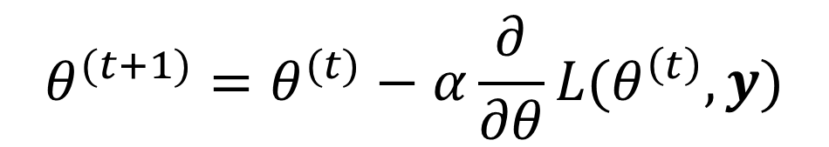
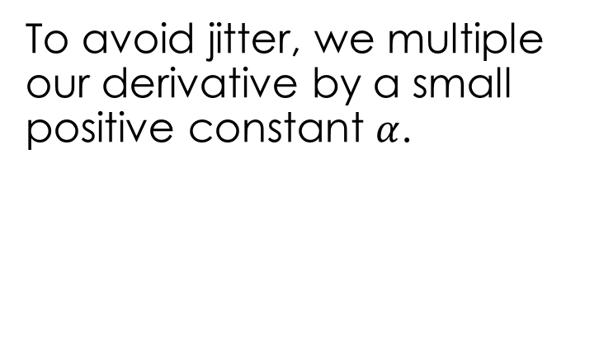
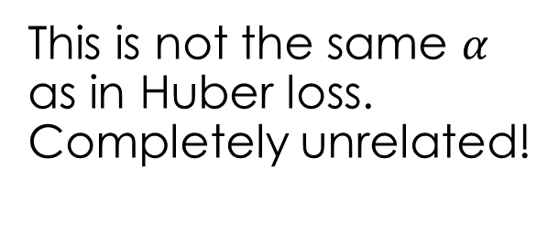
Minimizing the Loss Function Using Gradient Descent
To avoid jitter, we multiple our derivative by a small positive constant $α$.
$$θ^{(t+1)}=θ^{(t)}−α\frac{∂}{∂θ}L(θ^{\left(t\right)}, y)$$
squared_loss_derivative(0, data) * 0.4
-5.8
This is not the same $α$ as in Huber loss. Completely unrelated!
squared_loss_derivative(5.8, data)
-1.16
squared_loss_derivative(6.96, data)
-0.232
squared_loss_derivative(7.192, data)
-0.0464
squared_loss_derivative(7.2384, data)
...

Slide 30
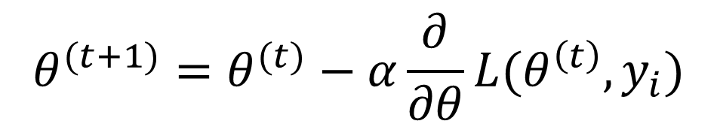
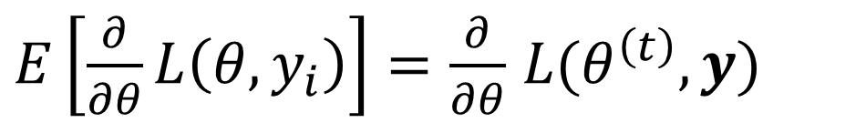
Stochastic Gradient Descent
Surprisingly, gradient descent converges to the same optimum if you only use one data point at a time, cycling through a new data point for each iteration.
$$θ^{(t+1)}=θ^{(t)}−α\frac{∂}{∂θ}L(θ^{\left(t\right)}, y_{i})$$
This is the loss for just one data point!
$E\left[\frac{∂}{∂θ}L\left(θ, y_{i}\right)\right]=\frac{∂}{∂θ}$ $L(θ^{\left(t\right)}, y)$

Slide 31
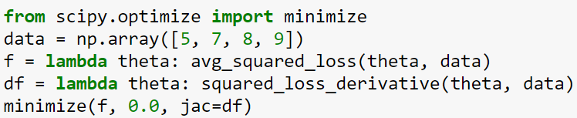
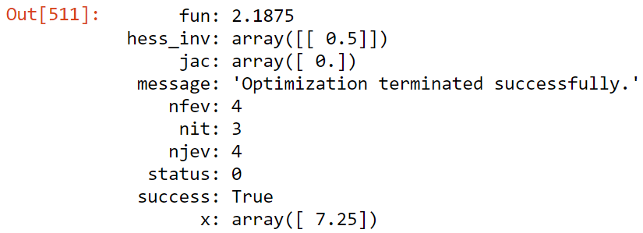
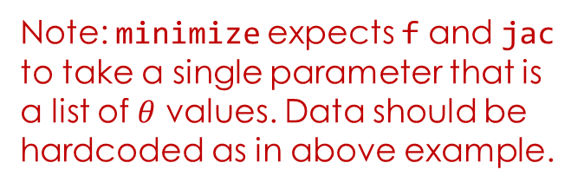
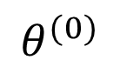
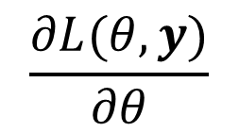
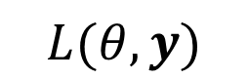
scipy.optimize.minimize
Scipy provides built-in optimization methods that are better than gradient descent.
The following are helpful properties when using numerical optimization methods:
convex loss function
smooth loss function
analytic derivative
$$L(θ, y)$$
$$θ^{(0)}$$
$$\frac{∂L(θ,y)}{∂θ}$$
(optional)
Note: minimize expects f and jac to take a single parameter that is a list of $θ$ values. Data should be hardcoded as in above example.

Slide 32
Multidimensional Models

Slide 33
Going beyond the simple model
How could we improve upon this model?
Things to consider when improving the model
Related factors to the quantity of interest
Examples: quality of service, table size, time of day, total bill
Do we have data for these factors?
The form of the relationship to the quantity of interest
Linear relationships, step functions, etc …
Goals for improving the model
Improve prediction accuracy → more complex models
Provide understanding → simpler models
Is my model “identifiable” (is it possible to estimate the parameters?)
percent tip = θ₁* + θ₂* ← many identical parameterizations

Slide 34
Rationale:
Larger bills result in larger tips and people tend to to be more careful or stingy on big tips.
Parameter Interpretation:
θ₁: Base tip percentage
θ₂: Reduction/increase in tip for an increase in total bill.
Often visualization can guide in the model design process.

Slide 35
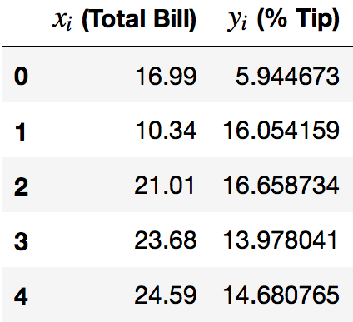
Estimating the model parameters:
Write the loss (e.g., average squared loss)
% Tip
Total Bill
n
Possible to optimize analytically (but it’s a huge pain!)
Let’s go through the algebra.
I don’t expect you to be able to follow this during lecture, it’s quite long.

Slide 36
Estimating the model parameters:
Write the loss (e.g., average squared loss)
Take the derivative(s):

Slide 37
Estimating the model parameters:
Write the loss (e.g., average squared loss)
Take the derivative(s):

Slide 38
Estimating the model parameters:
Write the loss (e.g., average squared loss)
Take the derivative(s):
Set derivatives equal to zero and solve for parameters

Slide 39
Solving for θ₁
Breaking apart the sum
0
Rearranging
Terms

Slide 40
Solving for θ₁
Divide by n
Define the average of x and y:

Slide 41
Solving for θ₂
Scratch
Distributing the x_{i} term
Breaking apart the sum

Slide 42
Solving for θ₂
Distributing the x_{i} term
Breaking apart the sum
Scratch
0
Rearranging
Terms
Divide by n

Slide 43
Solving for θ₂
Scratch

Slide 44
System of Linear Equations
Substituting θ₁ and solving for θ₂
solving for θ₂

Slide 45
System of Linear Equations
Substituting θ₁ and solving for θ₂
solving for θ₂
Algebra…
This has a neat interpretation, but it’s hard to digest in the middle of a lecture.
Notes:
The last expression requires extra algebra stored in the slides.
It looks more complex, but it has a useful interpretation:
- theta_2 is the ratio cov(x,y)/var(x)
- with theta_1, we see that y_mean = theta_1 + theta_2*x_mean.

Slide 46
Denominator Derivation
Completing the squares:
Skipped in Class

Slide 47
Numerator Derivation
Completing the squares:
Skipped in Class

Slide 48
Summary so far …
Step 1: Define the model with unknown parameters
Step 2: Write the loss (we selected an average squared loss)
Step3: Minimize the loss
Analytically (using calculus)
Numerically (using optimization algorithms)

Slide 49
Summary so far …
Step 1: Define the model with unknown parameters
Step 2: Write the loss (we selected an average squared loss)
Step3: Minimize the loss
Analytically (using calculus)
Numerically (using optimization algorithms)

Slide 50
Set derivatives equal to zero and solve for parameter values
Is this a minimum?
Yes. Proof 1: Use second partial derivative test (https://en.wikipedia.org/wiki/Second_partial_derivative_test).
Yes. Proof 2: Our loss function is convex, so any solution is guaranteed to be a minimum.

Slide 51
Set derivatives equal to zero and solve for parameter values
Is this a local minimum? (partial proof below, not covered in class)
Notes:
Note: I don’t think the stuff at the bottom is sufficient. It only checks two of the three partial derivatives, which is insufficient for the second deriviative test.

Slide 52
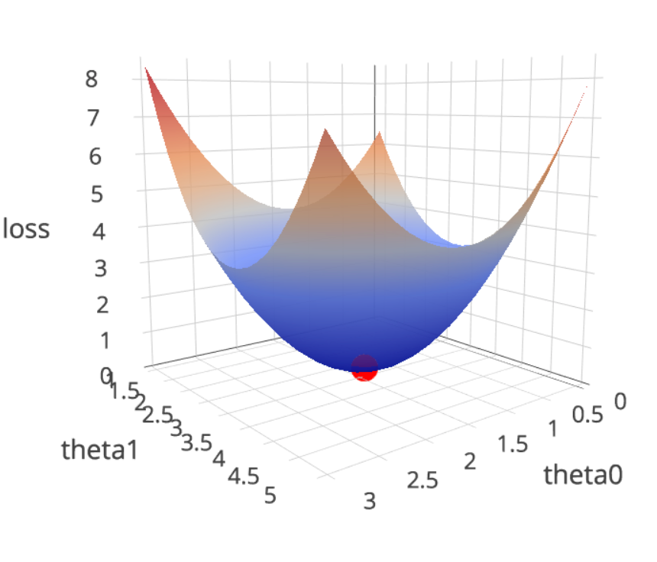
Visualizing the Higher Dimensional Loss
What does the loss look like?
Go to notebook …

Slide 53
Multi-Dimensional Gradient Descent

Slide 54
3D Gradient Descent (Intuitive)
The Loss Game:
http://www.ds100.org/fa18/assets/lectures/lec09/loss_game.html
https://tinyurl.com/3dloss18
Try playing until you get the “You Win!” message.
Attendance Quiz: yellkey.com/

Slide 55
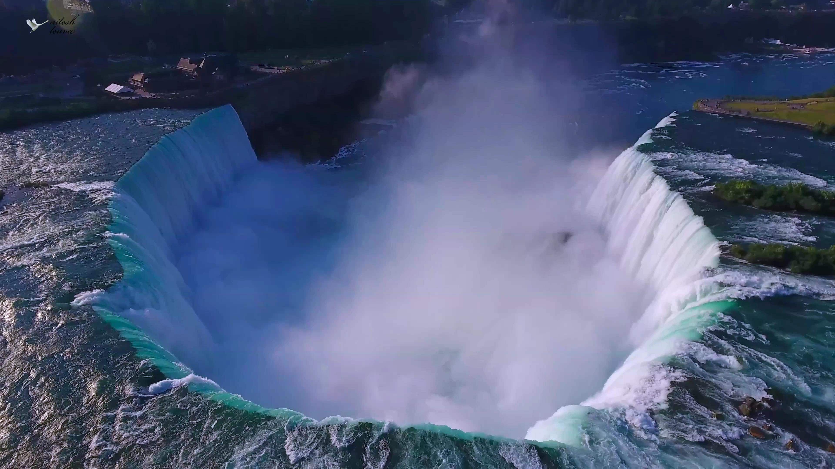
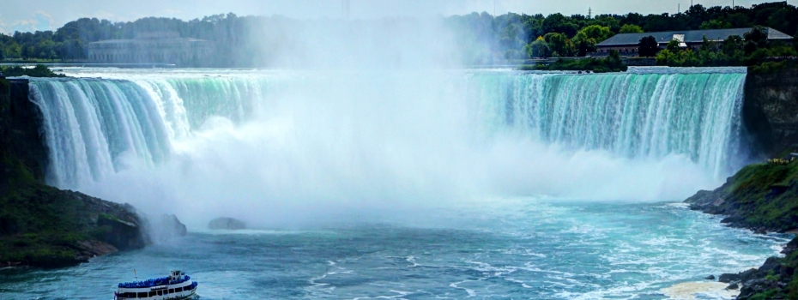
2D Gradient Descent (Intuitive)
On a 2D surface, the “best” way to go down is described by a 2 dimensional vector.
Notes:
From: https://www.google.com/imgres?imgurl=https%3A%2F%2Fi.ytimg.com%2Fvi%2FH9P_wkq08XA%2Fmaxresdefault.jpg&imgrefurl=https%3A%2F%2Fwww.youtube.com%2Fwatch%3Fv%3DH9P_wkq08XA&docid=1-_7sCwZlfSUsM&tbnid=BGPKy6ZyHHV1rM%3A&vet=10ahUKEwiywpLiw8rdAhUICnwKHVgoBrUQMwhjKCUwJQ..i&w=3840&h=2160&bih=1024&biw=1136&q=niagara%20falls%20isometric&ved=0ahUKEwiywpLiw8rdAhUICnwKHVgoBrUQMwhjKCUwJQ&iact=mrc&uact=8

Slide 56
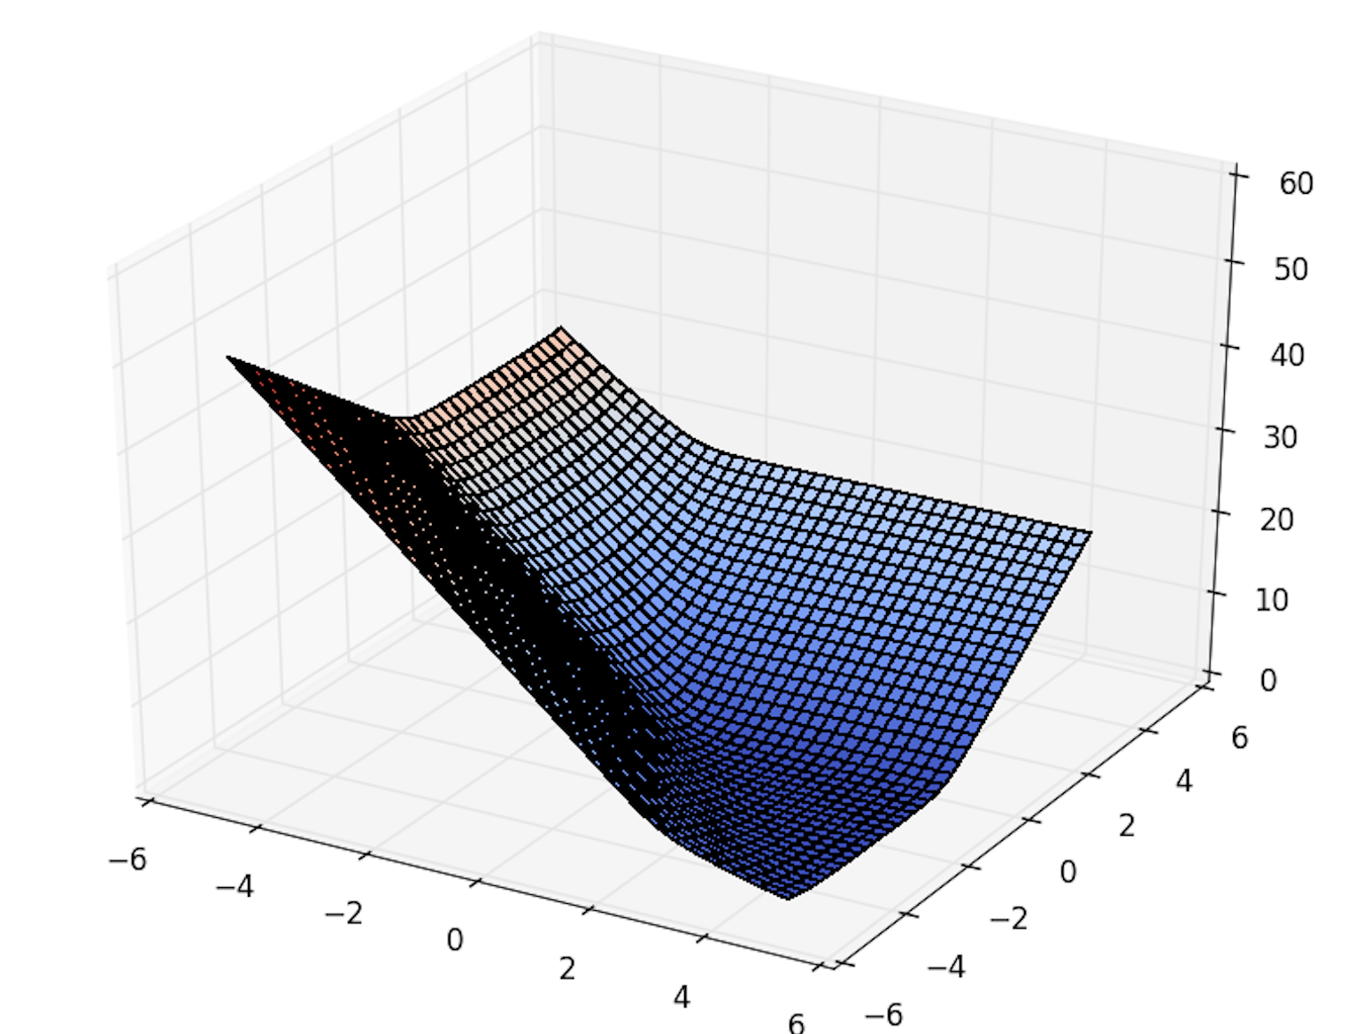
2D Gradient Descent (Intuitive)
On a 2D surface, the “best” way to go down is described by a 2 dimensional vector.
Notes:
From: https://www.google.com/imgres?imgurl=https%3A%2F%2Fi.ytimg.com%2Fvi%2FH9P_wkq08XA%2Fmaxresdefault.jpg&imgrefurl=https%3A%2F%2Fwww.youtube.com%2Fwatch%3Fv%3DH9P_wkq08XA&docid=1-_7sCwZlfSUsM&tbnid=BGPKy6ZyHHV1rM%3A&vet=10ahUKEwiywpLiw8rdAhUICnwKHVgoBrUQMwhjKCUwJQ..i&w=3840&h=2160&bih=1024&biw=1136&q=niagara%20falls%20isometric&ved=0ahUKEwiywpLiw8rdAhUICnwKHVgoBrUQMwhjKCUwJQ&iact=mrc&uact=8

Slide 57
2D Gradient Descent (Intuitive)
On a 2D surface, the “best” way to go down is described by a 2 dimensional vector.
Notes:
From: https://www.google.com/imgres?imgurl=https%3A%2F%2Fi.ytimg.com%2Fvi%2FH9P_wkq08XA%2Fmaxresdefault.jpg&imgrefurl=https%3A%2F%2Fwww.youtube.com%2Fwatch%3Fv%3DH9P_wkq08XA&docid=1-_7sCwZlfSUsM&tbnid=BGPKy6ZyHHV1rM%3A&vet=10ahUKEwiywpLiw8rdAhUICnwKHVgoBrUQMwhjKCUwJQ..i&w=3840&h=2160&bih=1024&biw=1136&q=niagara%20falls%20isometric&ved=0ahUKEwiywpLiw8rdAhUICnwKHVgoBrUQMwhjKCUwJQ&iact=mrc&uact=8

Slide 58
2D Gradient Descent (Intuitive)
On a 2D surface, the “best” way to go down is described by a 2 dimensional vector.
Notes:
From: https://www.google.com/imgres?imgurl=https%3A%2F%2Fi.ytimg.com%2Fvi%2FH9P_wkq08XA%2Fmaxresdefault.jpg&imgrefurl=https%3A%2F%2Fwww.youtube.com%2Fwatch%3Fv%3DH9P_wkq08XA&docid=1-_7sCwZlfSUsM&tbnid=BGPKy6ZyHHV1rM%3A&vet=10ahUKEwiywpLiw8rdAhUICnwKHVgoBrUQMwhjKCUwJQ..i&w=3840&h=2160&bih=1024&biw=1136&q=niagara%20falls%20isometric&ved=0ahUKEwiywpLiw8rdAhUICnwKHVgoBrUQMwhjKCUwJQ&iact=mrc&uact=8

Slide 59
Estimating the model parameters:
2 dimensional
generalization of slope

Slide 60
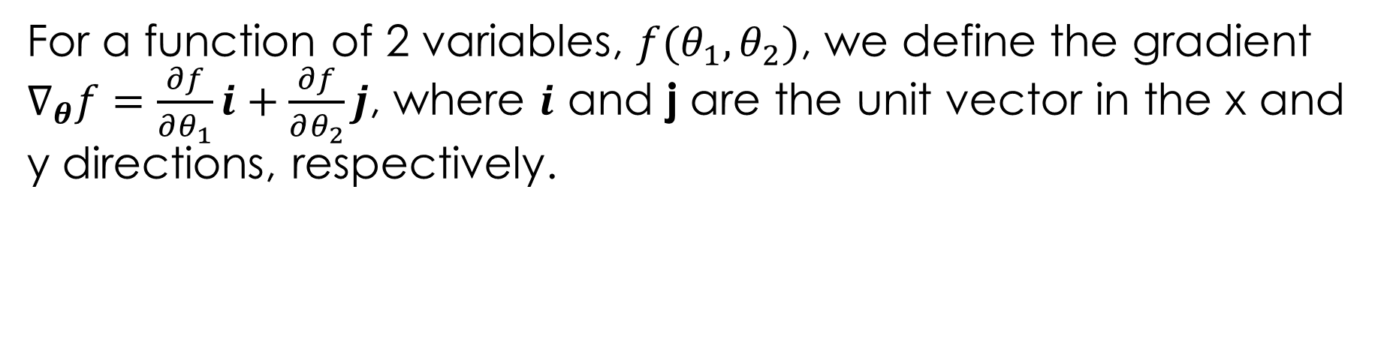
The Gradient of a Function
For a function of 2 variables, $f(θ_{1}, θ_{2})$, we define the gradient $∇_{θ}f=\frac{∂f}{∂θ_{1}}i+\frac{∂f}{∂θ_{2}}j$, where $i$ and j are the unit vector in the x and y directions, respectively.

Slide 61
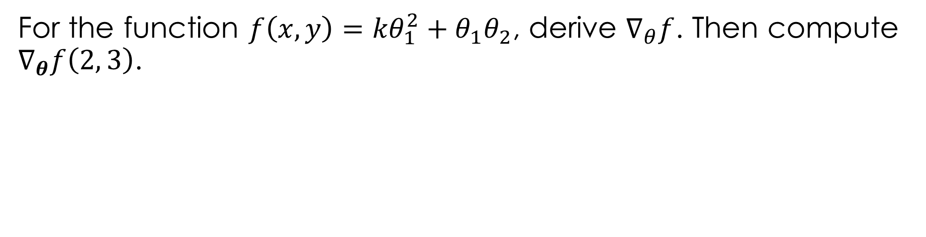
The Gradient of a Function
For a function of 2 variables, $f(θ_{1}, θ_{2})$, we define the gradient $∇_{θ}f=\frac{∂f}{∂θ_{1}}i+\frac{∂f}{∂θ_{2}}j$, where $i$ and j are the unit vector in the x and y directions, respectively.
For the function $f\left(x, y\right)={kθ}_{1}^{2}+θ_{1}θ_{2}$, derive $∇_{θ}f$. Then compute $∇_{θ}f\left(2, 3\right)$.

Slide 62
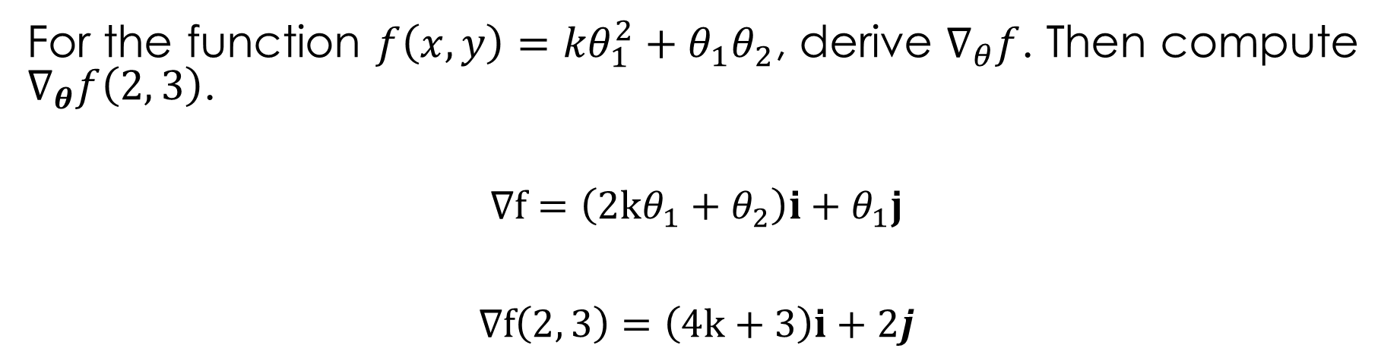
The Gradient of a Function
For a function of 2 variables, $f(θ_{1}, θ_{2})$, we define the gradient $∇_{θ}f=\frac{∂f}{∂θ_{1}}i+\frac{∂f}{∂θ_{2}}j$, where $i$ and j are the unit vector in the x and y directions, respectively.
For the function $f\left(x, y\right)={kθ}_{1}^{2}+θ_{1}θ_{2}$, derive $∇_{θ}f$. Then compute $∇_{θ}f\left(2, 3\right)$.
$$∇f=\left(2kθ_{1}+θ_{2}\right)i+θ_{1}j$$
$$∇f\left(2, 3\right)=\left(4k+3\right)i+2j$$

Slide 63


The Gradient of a Function in Column Vector Notation
In computer science, it is more common to use column vector notation for gradients. That is, for a function of 2 variables, $f(θ_{1}, θ_{2})$, we define the gradient $∇_{θ}f=\left[\frac{∂f}{∂θ_{1}},\frac{∂f}{∂θ_{2}}\right]$.
For the function $f\left(x, y\right)={kθ}_{1}^{2}+θ_{1}θ_{2}$:
$$∇_{θ}f=\left[2kθ_{1}+θ_{2},θ_{1}\right]$$
$$∇_{θ}f\left(2, 3\right)=\left[4k+3, 2\right]$$

Slide 64



Multi-Dimensional Gradients
Loss function
$f : ℝ^{p}→$ $ℝ$
Gradient:
$$∇_{θ}f\left(θ\right) : ℝ^{p}→ℝ^{p}$$
$$∇_{θ}f\left(θ\right)=\left[ \frac{∂}{∂θ_{1}}f\left(θ\right){\left.​\right|}_{θ},… ,\frac{∂}{∂θ_{p}}f\left(θ\right){\left.​\right|}_{θ}\right]$$
For Example:

Slide 65


Minimizing Multidimensional Loss Using Gradient Descent
$$θ^{(t+1)}=θ^{(t)}−α\frac{∂}{∂θ}L(θ^{\left(t\right)}, y)$$
Same idea as before!
Our exact python code from before still works!
$$θ^{(t+1)}=θ^{(t)}−α∇_{θ}L(θ^{\left(t\right)}, y)$$

Slide 66
“Improving” the Model (more…)

Slide 67
Rational:
Each term encodes a potential factor that could affect the percentage tip.
Possible Parameter Interpretation:
θ₁: base tip percentage paid by female non-smokers without accounting for table size.
θ₂: tip change associated with male patrons ...
Maybe difficult to estimate … what if all smokers are male?
Difficult to Plot
Go to Notebook

Slide 68

Define the model
Use python to define the function

Slide 69

Define and Minimize the Loss

Slide 70

Define and Minimize the Loss
Why?
Function is not smooth → Difficult to optimize

Slide 71

Define and Minimize the Loss

Slide 72
Summary of Model Estimation
Define the Model: simplified representation of the world
Use domain knowledge but … keep it simple!
Introduce parameters for the unknown quantities
Define the Loss Function: measures how well a particular instance of the model “fits” the data
We introduced L², L¹, and Huber losses for each record
Take the average loss over the entire dataset
Minimize the Loss Function: find the parameter values that minimize the loss on the data
We did this graphically
Minimize the loss analytically using calculus
Minimize the loss numerically

